Slide 1
Lecture 11
Graph

Slide 2
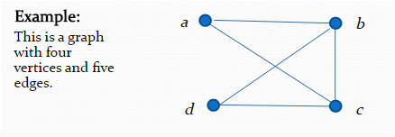
Introduction
A graph G = (V ,E) consists of V , a nonempty set of vertices (or nodes) and E, a set of edges. Each edge has either one or two vertices associated with it, called its endpoints. An edge is said to connect its endpoints.
The set of vertices V of a graph G may be infinite. A graph with an infinite vertex set or an infinite number of edges is called an infinite graph, and in comparison, a graph with a finite vertex set and a finite edge set is called a finite graph.

Slide 3
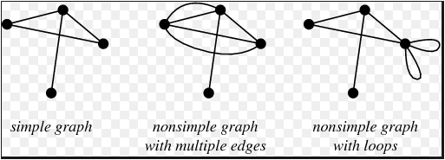
Some Terminology
In a simple graph each edge connects two different vertices and no more than one edge connects the same pair of vertices.
Multigraphs may have multiple edges connecting the same two vertices. When m different edges connect the same two vertices u and v, we say that {u,v} is an edge of multiplicity m.
An edge that connects a vertex to itself is called a loop.

Slide 4
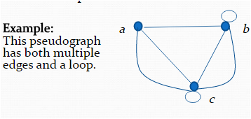
Some Terminology-Continue
A pseudograph may include loops as well as multiple edges connecting the same pair of vertices.

Slide 5
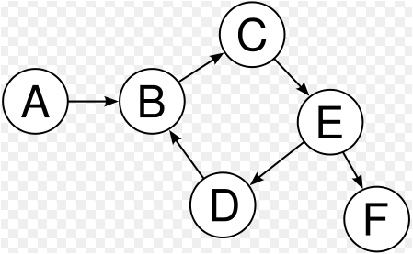
Digraph
A directed graph (or digraph) (V ,E) consists of a nonempty set of vertices V and a set of directed edges (or arcs) E. Each directed edge is associated with an ordered pair of vertices. The directed edge associated with the ordered pair (u, v) is said to start at u and end at v.

Slide 6
Application of Graph Theory
Everything in our world is linked: cities are linked by street, rail and flight networks.
Pages on the internet are linked by hyperlinks.
The different components of an electric circuit or computer chip are connected and the paths of disease outbreaks from a network.
Scientists, engineers and many others want to analyze, understand and optimize these networks.
All this can be done using graph theory.

Slide 7
Transportation Network
Mathematicians can apply graph theory to road networks, trying to find a way to reduce traffic congestion.
An idea which, if successful, could save millions every year, which are lost due to time spend on the road, as well as mitigating the enormous environmental impact.
It could also make life safer by allowing emergency services to travel faster and avoid car accidents in the first place.
This Intelligent Transportation Systems could work by collecting location data from smart phones of motorists and telling them where and how fast to drive in order to reduce overall congestion.

Slide 8
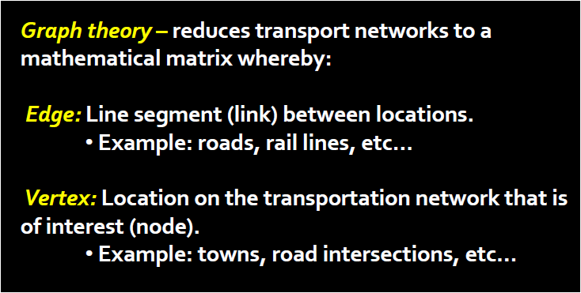
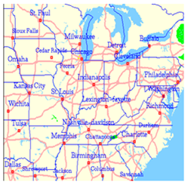
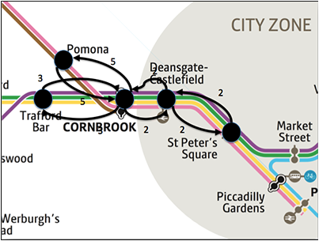
Transportation Network

Slide 9
Flight Network
Graph theory is already utilized in flight networks.
Airlines want to connect countless cities in the most efficient way, moving the most passengers with fewest possible trips.
At the same time, air traffic controllers need to make sure hundreds of planes are at the right place at the right time and don’t crash: an enormous task that would be almost impossible without computers and graph theory.

Slide 10
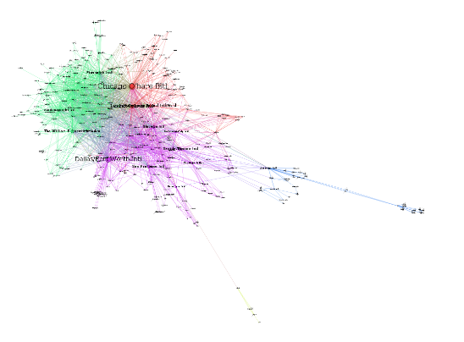
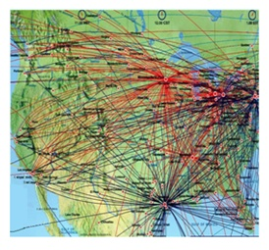
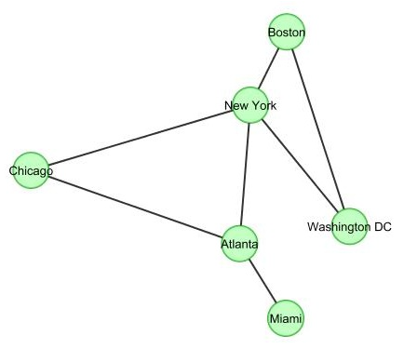
Flight Network
Flight Route in United States

Slide 11

Designing Computer Chips
One are where speed and the best connections are of crucial importance is the design of computer chips. Integrated circuits (ICs) consist of millions of transistors which need to be connected. Although the distances are only a few millimetres it is important to optimise the countless connections to improve the performance of the chip.

Slide 12
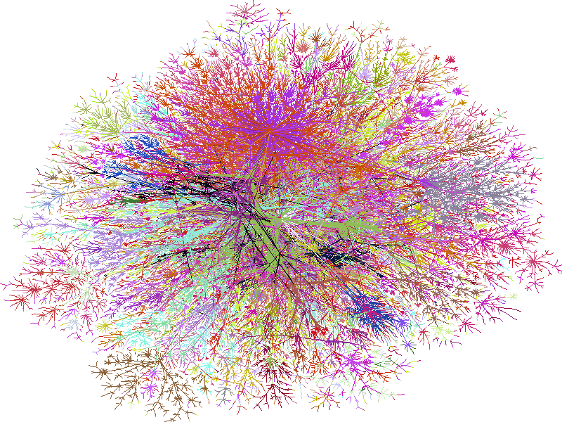

Digital Graphs-The Internet
In the recent years, there has been another important use of graph theory: the internet.
Every page in the internet could be a vertex in a graph, and whenever there is a link between two pages, there is an edge between the corresponding vertices. The resulting graph of course very, very large.

Slide 13

Digital Graphs-Internet

Slide 14
Digital Graphs-Facebook
There is another digital graph, of which you yourself are a part: Facebook. All the users form vertices and whenever two users are friends they are linked by an edge.
Graph theory can help web developers improve the performance of social networking sites, and it can help us understand Facebook better.
If I were to choose two users of Facebook completely at random, how many of these friendship edges do I need to get from one to another? One average you are less than six friends away from any other Facebook user: that’s globalization.

Slide 15

Digital Graphs-Facebook

Slide 16
Graph Terminology and Special Types of Graphs

Slide 17
Basic Terminology
Two vertices u and v in an undirected graph G are called adjacent (or neighbors) in G if u and v are endpoints of an edge e of G. Such an edge e is called incident with the vertices u and v and e is said to connect u and v.
The set of all neighbors of a vertex v of G = (V ,E), denoted by N(v), is called the neighborhood of v.
The degree of a vertex in an undirected graph is the number of edges incident with it, except that a loop at a vertex contributes twice to the degree of that vertex. The degree of the vertex v is denoted by deg(v).

Slide 18
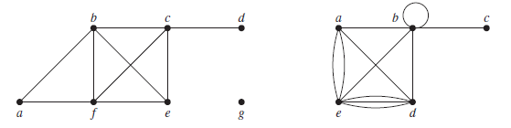
Example
What are the degrees and what are the neighborhoods of the vertices in the graphs G and H displayed in Figure below?

Slide 19
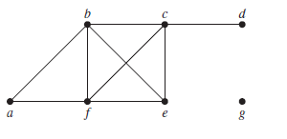
Solution
In G, deg(a) = 2, deg(b) = deg(c) = deg(f ) = 4, deg(d ) = 1, deg(e) = 3, and deg(g) = 0.
The neighborhoods of these vertices are N(a) = {b, f }, N(b) = {a, c, e, f},
N(c) = {b, d, e, f }, N(d) = {c}, N(e) = {b, c, f }, N(f ) = {a, b, c, e}, and N(g) = ∅.

Slide 20
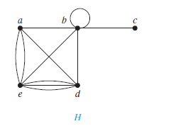
Continue
In H, deg(a) = 4, deg(b) = deg(e) = 6, deg(c) = 1, and deg(d ) = 5. The neighborhoods of these vertices are N(a) = {b, d, e}, N(b) = {a, b, c, d, e}, N(c) = {b}, N(d) = {a, b, e}, and N(e) = {a, b, d}.

Slide 21
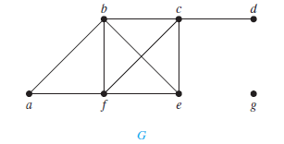
Definition
A vertex of degree zero is called isolated. It follows that an isolated vertex is not adjacent to any vertex. Vertex g in graph G is isolated.
A vertex is pendant if and only if it has degree one. Consequently, a pendant vertex is adjacent to exactly one other vertex. Vertex d in graph G is pendant.

Slide 22
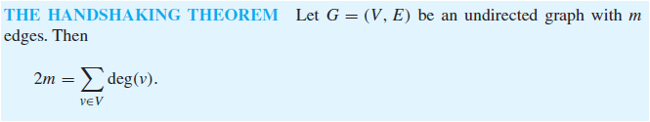
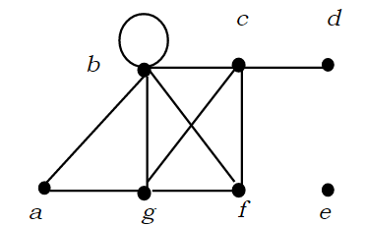
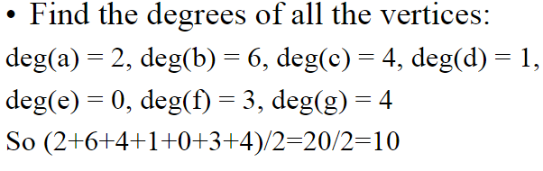
Theorem
Handshaking theorem states that the sum of degrees of the vertices of a graph is twice the number of edges.

Slide 23
Example
How many edges are there in a graph with 10 vertices each of degree six?
Solution
Because the sum of the degrees of the vertices is 6 ・ 10 = 60, it follows that 2m = 60 where m is the number of edges. Therefore, m = 30.
Points to know
The sum of the degrees of the vertices of an undirected graph is even.

Slide 24
Example
If a graph has 5 vertices, can each vertex have degree 3?
Solution
This is not possible by the handshaking theorem because the sum of the degrees of the vertices 3·5= 15 is odd.

Slide 25
Example
Draw a graph with 4 edges and 4 vertices, having degrees 1,2, 3,4.
Solution
No such graph exists. The sum of the degrees of all the vertices should be equal to twice the number of edges.
Half of the sum of the degree is 5, which is not equal to actual number of edges required in the question (4).
(1+2+3+4)/2=5, 5≠4.

Slide 26
Definition
When (u, v) is an edge of the graph G with directed edges, u is said to be adjacent to v and v is said to be adjacent from u. The vertex u is called the initial vertex of (u, v), and v is called the terminal or end vertex of (u, v). The initial vertex and terminal vertex of a loop are the same.
In a graph with directed edges the in-degree of a vertex v, denoted by deg⁻(v), is the number of edges with v as their terminal vertex.
The out-degree of v, denoted by deg⁺ (v), is the number of edges with v as their initial vertex.
(Note that a loop at a vertex contributes 1 to both the in-degree and the out-degree of this vertex.)

Slide 27
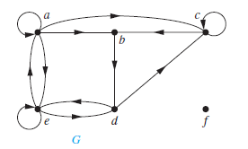
Example
Find the in-degree and out-degree of each vertex in the graph G with directed edges shown in Figure below.
Solution
The in-degrees in G are deg⁻(a) = 2, deg⁻ (b) = 2, deg⁻ (c) = 3, deg⁻ (d) = 2, deg⁻(e) = 3, and deg⁻ (f ) = 0.
The out-degrees are deg⁺(a) = 4, deg⁺ (b) = 1, deg⁺ (c) = 2, deg⁺(d) = 2, deg⁺ (e) = 3, and deg⁺ (f ) = 0.

Slide 28
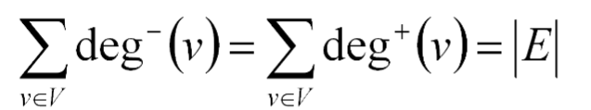
Theorem
Let G = (V ,E) be a graph with directed edges. Then

Slide 29
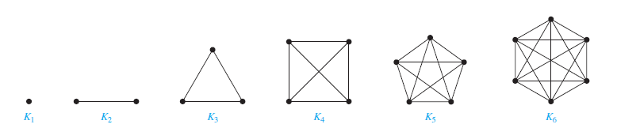

Complete Graphs
Complete Graphs A complete graph on n vertices, denoted by K_{n}, is a simple graph that contains exactly one edge between each pair of distinct vertices. The graphs K_{n}, for n = 1, 2, 3, 4, 5, 6, are displayed in Figure below. A simple graph for which there is at least one pair of distinct vertex not connected by an edge is called noncomplete.

Slide 30
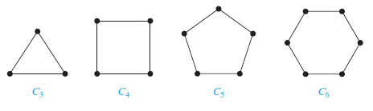

Cycles
A cycle C_{n}, n ≥ 3, consists of n vertices v₁, v₂, . . . , v_{n} and edges {v₁, v₂}, {v₂, v₃}, . . . , {v_{n−1}, v_{n}}, and {v_{n}, v₁}. The cycles C₃, C₄, C₅, and C₆ are displayed in Figure below.

Slide 31
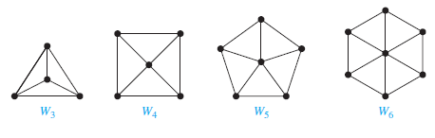

Wheels
We obtain a wheel W_{n} when we add an additional vertex to a cycle C_{n}, for n ≥ 3, and connect this new vertex to each of the n vertices in C_{n}, by new edges. The wheels W₃, W₄, W₅, and W₆ are displayed in Figure below.

Slide 32
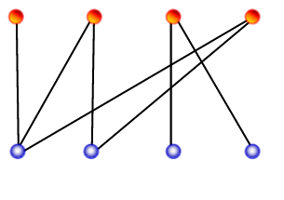
Bipartite Graphs
A simple graph G is called bipartite if its vertex set V can be partitioned into two disjoint sets V₁ and V₂ such that every edge in the graph connects a vertex in V₁ and a vertex in V₂ (so that no edge in G connects either two vertices in V₁ or two vertices in V₂). When this condition holds, we call the pair (V₁, V₂) a bipartition of the vertex set V of G.

Slide 33
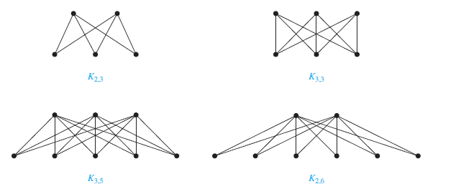
Complete Bipartite Graphs
A complete bipartite graph K_{m,n} is a graph that has its vertex set partitioned into two subsets of m and n vertices, respectively with an edge between two vertices if and only if one vertex is in the first subset and the other vertex is in the second subset. The complete bipartite graphs K_{2,3}, K_{3,3}, K_{3,5}, and K_{2,6} are displayed in Figure below.

Slide 34
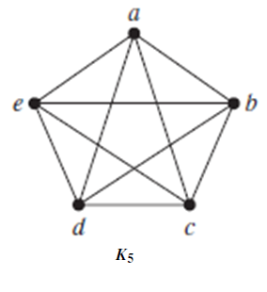
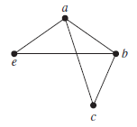
Subgraph
A subgraph of a graph G = (V ,E) is a graph H = (W, F), where W ⊆ V and F ⊆ E. A subgraph H of G is a proper subgraph of G if H ≠ G.
The graph G shown in Figure is a subgraph of K₅.

Slide 35
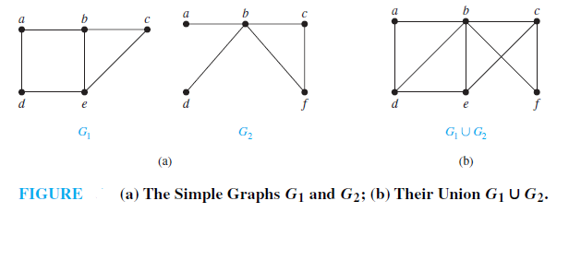
Union of two graphs
The union of two simple graphs G₁ = (V₁,E₁) and G₂ = (V₂,E₂) is the simple graph with vertex set V₁ ∪ V₂ and edge set E₁ ∪ E₂. The union of G₁ and G₂ is denoted by G₁ ∪ G₂.
Example
Find the union of the graphs G1 and G2 shown in Figure (a).
Solution
The vertex set of the union G1 ∪ G2 is the union of the two vertex sets, namely, {a, b, c, d, e, f }. The edge set of the union is the union of the two edge sets.

Slide 36
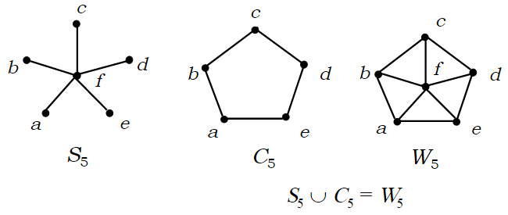
Example

Slide 37
Representing Graphs

Slide 38
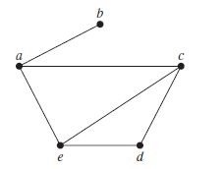
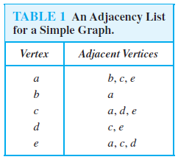
Adjacency lists
One way to represent a graph with no multiple edges is to use adjacency lists, which specify the vertices that are adjacent to each vertex of the graph.
Example
Use adjacency lists to describe the simple graph given in Figure below:
Solution

Slide 39
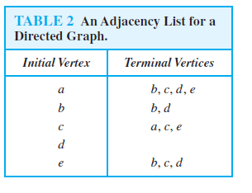
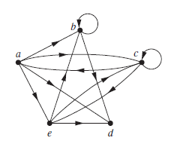
Example
Represent the directed graph shown in Figure below by listing all the vertices that are the terminal vertices of edges starting at each vertex of the graph.

Slide 40

Adjacency Matrices
Suppose that G = (V ,E) is a simple graph where |V| = n. Suppose that the vertices of G are listed arbitrarily as v₁, v₂, . . . , v_{n}. The adjacency matrix A (or A_{G}) of G, with respect to this listing of the vertices, is the n × n zero–one matrix with 1 as its (i, j )th entry when v_{i} and v_{j} are adjacent, and 0 as its (i, j )th entry when they are not adjacent. In other words, if its adjacency matrix is A = [a_{ij} ], then

Slide 41
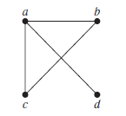
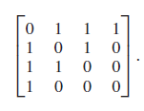
Example
Use an adjacency matrix to represent the graph shown in Figure below
Solution: We order the vertices as a, b, c, d. The matrix representing this graph is

Slide 42
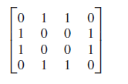
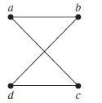
Example
Draw a graph with the adjacency matrix
with respect to the ordering of vertices a, b, c, d.
Solution

Slide 43
Adjacency Matrices-Continue
Adjacency matrices can also be used to represent undirected graphs with loops and with multiple edges. A loop at the vertex v_{i} is represented by a 1 at the (i, i)th position of the adjacency matrix. When multiple edges connecting the same pair of vertices v_{i} and v_{j}, or multiple loops at the same vertex, are present, the adjacency matrix is no longer a zero–one
matrix, because the (i, j )th entry of this matrix equals the number of edges that are associated to {v_{i} , v_{j} }.

Slide 44
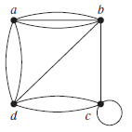
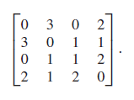
Example
Use an adjacency matrix to represent the pseudograph shown in Figure below.
The adjacency matrix using the ordering of vertices a, b, c, d is

Slide 45

Incidence Matrices
Let G = (V ,E) be an undirected graph. Suppose that v₁, v₂, . . . , v_{n} are the vertices and e₁, e₂, . . . , e_{m} are the edges of G. Then the incidence matrix with respect to this ordering of V and E is the n × m matrix M = [m_{ij} ], where

Slide 46
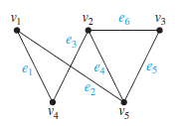
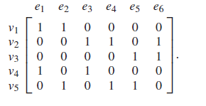
Example
Represent the graph shown in Figure below with an incidence matrix.
Solution
The incidence matrix is

Slide 47
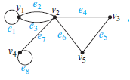
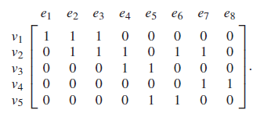
Example
Represent the pseudograph shown in Figure below using an incidence matrix.
Solution
The incidence matrix for this graph is

Slide 48
Isomorphism of Graphs
The simple graphs G₁ = (V₁,E₁) and G₂ = (V₂,E₂) are isomorphic if there exists a one to-one and onto function f from V₁ to V₂ with the property that a and b are adjacent in G₁ if and only if f (a) and f (b) are adjacent in G₂, for all a and b in V₁. Such a function f is called an isomorphism. Two simple graphs that are not isomorphic are called nonisomorphic.
In other words, when two simple graphs are isomorphic, there is a one-to-one correspondence between vertices of the two graphs that preserves the adjacency relationship.

Slide 49
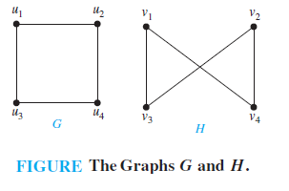
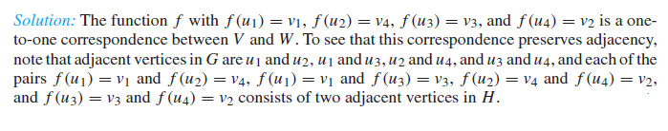
Isomorphism of Graphs
Show that the graphs G = (V ,E) and H = (W, F), displayed in Figure below, are isomorphic.
Solution

Slide 50
Determining whether Two Simple Graphs are Isomorphic
Isomorphic simple graphs must have the same number of vertices, because there is a one-to-one correspondence between the sets of vertices of the graphs.
Isomorphic simple graphs also must have the same number of edges, because the one-to-one correspondence between vertices establishes a one-to-one correspondence between edges.
In addition, the degrees of the vertices in isomorphic simple graphs must be the same.

Slide 51
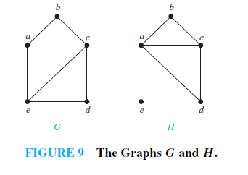
Example
Show that the graphs displayed in the following figure are not isomorphic.
Solution
Both G and H have five vertices and six edges. However, H has a vertex of degree one, namely, e, whereas G has no vertices of degree one. It follows that G and H are not isomorphic.

Slide 52
Determining whether Two Simple Graphs are Isomorphic-Continue
The number of vertices, the number of edges, and the number of vertices of each degree are all invariants under isomorphism.
If any of these quantities differ in two simple graphs, these graphs cannot be isomorphic.
However, when these invariants are the same, it does not necessarily mean that the two graphs are isomorphic.
There are no useful sets of invariants currently known that can be used to determine whether simple graphs are isomorphic.

Slide 53
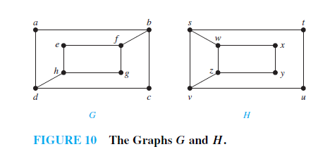
Example
Determine whether the graphs shown in Figure 10 are isomorphic.
Solution
The graphs G and H both have eight vertices and 10 edges. They also both have four vertices of degree two and four of degree three. Because these invariants all agree, it is still conceivable that these graphs are isomorphic

Slide 54
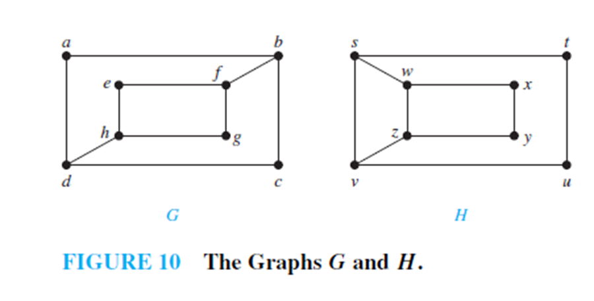
Solution
However, G and H are not isomorphic. To see this, note that because deg(a) = 2 in G, a must correspond to either t , u, x, or y in H, because these are the vertices of degree two in H.
However, each of these four vertices in H is adjacent to another vertex of degree two in H, which is not true for a in G.

Slide 55
Path and Circuit
A path is a sequence of edges that begins at a vertex of a graph and travels from vertex to vertex along edges of the graph. As the path travels along its edges, it visits the vertices along this path, that is, the endpoints of these edges.
The path is a circuit if it begins and ends at the same vertex, and has length greater than zero.

Slide 56
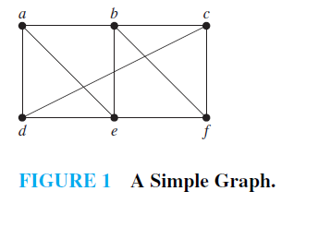
Example
In the simple graph shown in Figure 1, a, d, c, f , e is a simple path of length 4, because {a, d}, {d, c}, {c, f }, and {f, e} are all edges. However, d, e, c, a is not a path, because {e, c} is not an edge.
Note that b, c, f , e, b is a circuit of length 4 because {b, c}, {c, f }, {f, e}, and {e, b} are edges, and this path begins and ends at b. The path a, b, e, d, a, b, which is of length 5, is not simple because it contains the edge {a, b} twice.

Slide 57
Connected Graph
An undirected graph is called connected if there is a path between every pair of distinct vertices of the graph.
An undirected graph that is not connected is called disconnected. We say that we disconnect a graph when we remove vertices or edges, or both, to produce a disconnected subgraph.

Slide 58
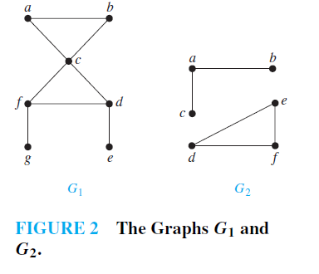
Example
The graph G₁ in Figure 2 is connected, because for every pair of distinct vertices there is a path between them (the reader should verify this). However, the graph G₂ in Figure 2 is not connected. For instance, there is no path in G₂ between vertices a and d.

Slide 59
Planner Graph

Slide 60
Definition
A graph is called planar if it can be drawn in the plane without any edges crossing (where a crossing of edges is the intersection of the lines or arcs representing them at a point other than their common endpoint). Such a drawing is called a planar representation of the graph.
A graph may be planar even if it is usually drawn with crossings, because it may be possible to draw it in a different way without crossings.

Slide 61


Example
Is K₄ (shown in Figure 2 with two edges crossing) planar?
Solution
K₄ is planar because it can be drawn without crossings, as shown in Figure 3.

Slide 62

Example
Is Q₃, shown in Figure 4, planar?
Solution
Q3 is planar, because it can be drawn without any edges crossing, as shown in Figure 5.

Slide 63


Example
Is K_{3,3}, shown in Figure 6, planar?
Solution:Any attempt to draw K_{3,3} in the plane with no edges crossing is doomed.
We now show why. In any planar representation of K_{3,3}, the vertices v₁ and v₂ must be connected to both v₄ and v₅. These four edges form a closed curve that splits the plane into two regions, R₁ and R₂, as shown in Figure 7(a). The vertex v₃ is in either R₁ or R₂.

Slide 64

Solution-Continue
When v₃ is in R₂, the inside of the closed curve, the edges between v₃ and v₄ and between v₃ and v₅ separate R₂ into two subregions, R₂₁ and R₂₂, as shown in Figure 7(b).

Slide 65
Solution-Continue
Next, note that there is no way to place the final vertex v₆ without forcing a crossing. For if v₆ is in R₁, then the edge between v₆ and v₃ cannot be drawn without a crossing. If v₆ is in R₂₁, then the edge between v₂ and v₆ cannot be drawn without a crossing. If v₆ is in R₂₂, then the edge between v₁ and v₆ cannot be drawn without a crossing.

Slide 66

Euler’s Formula
A planar representation of a graph splits the plane into regions, including an unbounded region. For instance, the planar representation of the graph shown in Figure 8 splits the plane into six regions. These are labeled in the figure.

Slide 67

Theorem
Let G be a connected planar simple graph with e edges and v vertices. Let r be the number of regions in a planar representation of G. Then r = e − v + 2.

Slide 68

Example
Suppose that a connected planar simple graph has 20 vertices, each of degree 3. Into how many regions does a representation of this planar graph split the plane?
Solution
This graph has 20 vertices, each of degree 3, so v = 20. Because the sum of the degrees of the vertices, 3v = 3 ・ 20 = 60, is equal to twice the number of edges, 2e, we have 2e = 60, or e = 30. Consequently, from Euler’s formula, the number of regions is

Slide 69
Proof of Euler’s formula
Before we try to prove Euler’s formula, let’s look at one special type of planar graph: trees. In graph theory, a tree is any connected graph with no cycles. When we normally think of a tree, it has a designated root (top) vertex. In graph theory, these are called rooted trees.
A tree doesn’t divide the plane into multiple regions, because it doesn’t contain any cycles. In graph theory jargon, a tree has only one face: the entire plane surrounding it. So Euler’s theorem reduces to v − e = 1, i.e. e = v − 1. It can be proved by induction.
We can now prove Euler’s formula (v − e + f = 2) works in general, for any connected simple planar graph.

Slide 70
Proof of Euler’s formula-Continue
Proof: by induction on the number of edges in the graph.
Base: If e = 0, the graph consists of a single vertex with a single region surrounding it. So we have 1 − 0 + 1 = 2 which is clearly right.
Induction: Suppose the formula works for all graphs with no more than n edges. Let G be a graph with n + 1 edges.
Case 1: G doesn’t contain a cycle. So G is a tree and we already know the formula works for trees.

Slide 71
Proof of Euler’s formula-Continue
Case 2: G contains at least one cycle. Pick an edge p that’s on a cycle. Remove p to create a new graph G′.
Since the cycle separates the plane into two regions, the regions to either side of p must be distinct. When we remove the edge p, we merge these two regions. So G′ has one fewer regions than G.
Since G′ has n edges, the formula works for G′ by the induction hypothesis. That is v′ − e′ + f′ = 2. But v′ = v, e′ = e − 1, and f′ = f − 1. Substituting, we find that
v − (e − 1) + (f − 1) = 2
So
v − e + f = 2

Slide 72

Corollary
If G is a connected planar simple graph with e edges and v vertices, where v ≥ 3, then e ≤ 3v − 6.
Example
Show that K₅ is nonplanar.
Solution
The graph K₅ has five vertices and 10 edges. However, the inequality e ≤ 3v − 6 is not satisfied for this graph because e = 10 and 3v − 6 = 9. Therefore, K₅ is not planar.

Slide 73

Kuratowski’s Theorem
We have seen that K_{3,3} and K₅ are not planar. Clearly, a graph is not planar if it contains either of these two graphs as a subgraph.
Surprisingly, all nonplanar graphs must contain a subgraph that can be obtained from K_{3,3} or K₅ using certain permitted operations.

Slide 74
Homeomorphic
If a graph is planar, so will be any graph obtained by removing an edge {u, v} and adding a new vertex w together with edges {u,w} and {w, v}. Such an operation is called an elementary subdivision.
The graphs G₁ = (V₁,E₁) and G₂ = (V₂,E₂) are called homeomorphic if they can be obtained from the same graph by a sequence of elementary subdivisions.

Slide 75

Homeomorphic
Show that the graphs G₁ and G₂ displayed in Figure 12 are all homeomorphic.

Slide 76
Solution
These two graphs are homeomorphic because all two can be obtained from G₁ by elementary subdivisions. G₁ can be obtained from itself by an empty sequence of elementary subdivisions.
To obtain G₂ from G₁ we can use this sequence of elementary subdivisions:
(i ) remove the edge {a, c}, add the vertex f , and add the edges {a, f } and {f, c};
(ii ) remove the edge {b, c}, add the vertex g, and add the edges {b, g} and {g, c}; and
(iii ) remove the edge {b, g}, add the vertex h, and add the edges {g, h} and {b, h}.

Slide 77

Theorem
A graph is nonplanar if and only if it contains a subgraph homeomorphic to K_{3,3} or K₅.
Example
Determine whether the graph G shown in Figure 13 is planar.

Slide 78
Solution
G has a subgraph H homeomorphic to K₅. H is obtained by deleting h, j , and k and all edges incident with these vertices. H is homeomorphic to K₅ because it can be obtained from K₅ (with vertices a, b, c, g, and i) by a sequence of elementary subdivisions, adding the vertices d, e, and f . Hence, G is nonplanar.

Slide 79
Eulerian and Hamiltonian Graph

Slide 80


Königsberg Bridge Problem
Leonhard Euler's paper on “Seven Bridges of Königsberg” , published in 1736.
Leonard Eüler
  Visited Koenigsberg
  People wondered whether it is possible to take a walk, end up where you started from, and cross each bridge in Koenigsberg exactly once
  Generally it was believed to be impossible

Slide 81

Königsberg Bridge Problem-Continue

Slide 82

Königsberg Bridge Problem-Continue
Is it possible to start in A, cross over each bridge exactly once, and end up back in A?

Slide 83

Königsberg Bridge Problem-Continue
Conceptualization: Land masses are “nodes”.

Slide 84

Königsberg Bridge Problem-Continue
Conceptualization: Bridges are “arcs.”

Slide 85

Königsberg Bridge Problem-Continue
Is there a “walk” starting at A and ending at A and passing through each arc exactly once?

Slide 86

Euler Circuits and Paths
An Euler circuit in a graph G is a simple circuit containing every edge of G. An Euler path in G is a simple path containing every edge of G.
Example
Which of the undirected graphs in Figure 3 have an Euler circuit? Of those that do not, which have an Euler path?

Slide 87

Solution
The graph G₁ has an Euler circuit, for example, a, e, c, d, e, b, a. Neither of the graphs G₂ or G₃ has an Euler circuit .
However, G₃ has an Euler path, namely, a, c, d, e, b, d, a, b. G₂ does not have an Euler path.
In graph theory, an Eulerian trail (or Eulerian path) is a trail in a graph which visits every edge exactly once. Similarly, an Eulerian circuit or Eulerian cycle is an Eulerian trail which starts and ends on the same vertex.

Slide 88

Example
Which of the directed graphs in Figure 4 have an Euler circuit? Of those that do not, which have an Euler path?
Solution
The graph H₂ has an Euler circuit, for example, a, g, c, b, g, e, d, f, a. Neither H₁ nor H₃ has an Euler circuit . H₃ has an Euler path, namely, c, a, b, c, d, b, but H₁ does not.

Slide 89
Necessary and Sufficient Conditions for Euler Circuits and Paths
What is the condition if a connected multigraph has an Euler circuit? This is done if we can show that every vertex must have even degree.
Let us suppose that one Euler circuit begins with a vertex a, and continues with an edge incident to a, say {a, b}. The edge contributes 1 to deg(a). Each time the circuit passes through a vertex it contributes 2 to the vertex’s degree. This is because the circuit enters from an edge incident with this vertex and leaves via another such edge. Finally the circuit terminates at the point it originated: say at vertex a, contributing 1 to deg(a).

Slide 90
Continue
Therefore, deg(a) must be even, because the circuit contributes 1 when it begins, and 1 when it ends, and 2 every time it passes through a.
A vertex other than a has even degree because the circuit contributes 2 to its degree each time it passes through the vertex.
We conclude that if a connected graph has an Euler circuit, then every vertex must have even degree.
Theorem
A connected multigraph with at least two vertices has an Euler circuit if and only if each of its vertices has even degree.

Slide 91
Königsberg Bridge Problem-Continue
Now let us try to solve the Königsberg bridge problem. Let us see the Euler’s graph of the Königsberg bridges here again: This graph has four vertices of odd degree: deg (a) = 5, deg (b) = 3, deg (c) = 3 and deg (d) = 3. So it does not have an Euler circuit. There is no way to start from one point, cross each bridge once, and then come back to the starting point.

Slide 92

Theorem
A connected multigraph has an Euler path but not an Euler circuit if and only if it has exactly two vertices of odd degree.
Problem
Which graphs shown in Figure 7 have an Euler path?

Slide 93
Solution
G₁ contains exactly two vertices of odd degree, namely, b and d. Hence, it has an Euler path that must have b and d as its endpoints. One such Euler path is d, a, b, c, d, b.
Similarly,G₂ has exactly two vertices of odd degree, namely, b and d. So it has an Euler path that must have b and d as endpoints. One such Euler path is b, a, g, f, e, d, c, g, b, c, f, d.
G₃ has no Euler path because it has six vertices of odd degree.

Slide 94
Hamilton Paths and Circuits
A simple path in a graph G that passes through every vertex exactly once is called a Hamilton path, and a simple circuit in a graph G that passes through every vertex exactly once is called a Hamilton circuit. That is, the simple path x₀, x₁, . . . , x_{n−1}, x_{n} in the graph G = (V ,E) is a Hamilton path if V = {x₀, x₁, . . . , x_{n−1}, x_{n}} and x_{i} ≠ x_{j} for 0 ≤ i < j ≤ n, and the simple circuit x₀, x₁, . . . , x_{n−1}, x_{n}, x₀ (with n > 0) is a Hamilton circuit if x₀, x₁, . . . , x_{n−1}, x_{n} is a Hamilton path.

Slide 95

Example
Which of the simple graphs in Figure 10 have a Hamilton circuit or, if not, a Hamilton path?
G₁ has a Hamilton circuit: a, b, c, d, e, a.
There is no Hamilton circuit in G₂ ( this can be seen by noting that any circuit containing every vertex must contain the edge {a, b} twice), but G₂ does have a Hamilton path, namely, a, b, c, d.
G₃ has neither a Hamilton circuit nor a Hamilton path, because any path containing all vertices must contain one of the edges {a, b}, {e, f }, and {c, d} more than once.

Slide 96
Conditions for the Existence of Hamilton Circuits
There are no known simple necessary and sufficient theorems for the existence of Hamiltonian circuits. Still there are some properties can be devised that may provide some give necessary conditions for Hamiltonian circuits.
Rule 1: A graph with a vertex of degree one cannot have a Hamilton circuit, because in a Hamilton circuit, each vertex is incident with two edges in the circuit.
Rule 2: If a vertex in the graph has degree two, then both edges that are incident with this vertex must be part of any Hamilton circuit.

Slide 97

Conditions for the Existence of Hamilton Circuits-Continue
Rule 3: When a Hamilton circuit is being constructed and this circuit has passed through a vertex, then all remaining edges incident with this vertex, other than the two used in the circuit, must be removed from consideration.
Rule 4: No proper sub-circuit, that is, a circuit not containing all vertices, can be formed when building a Hamilton Circuit
https://www.youtube.com/watch?v=IADKmt_fXbM

Slide 98

Example
Show that neither graph displayed in Figure 11 has a Hamilton circuit.
Solution
There is no Hamilton circuit in G because G has a vertex of degree one, namely, e.
Now consider H. Because the degrees of the vertices a, b, d, and e are all two, every edge incident with these vertices must be part of any Hamilton circuit. It is now easy to see that no Hamilton circuit can exist in H, for any Hamilton circuit would have to contain four edges incident with c, which is impossible.

Slide 99

Example
Find a Hamilton circuit in the following graph if one exists. If one doesn’t then explain why.
Solution
a-f-b-g-c-h-d-e-a is forced by Rule Two, and then forms a subcircuit, violating Rule Three.

Slide 100
Graph Coloring Techniques and Application

Slide 101
Introduction
A coloring of a simple graph is the assignment of a color to each vertex of the graph so that no two adjacent vertices are assigned the same color.
A graph can be colored by assigning a different color to each of its vertices. However, for most graphs a coloring can be found that uses fewer colors than the number of vertices in the graph. What is the least number of colors necessary?
The chromatic number of a graph is the least number of colors needed for a coloring of this graph. The chromatic number of a graph G is denoted by χ (G). (Here χ is the Greek letter chi.)

Slide 102

The Four Color Theorem
The chromatic number of a planar graph is no greater than four.
Example
What are the chromatic numbers of the graphs G and H shown in Figure 3?

Slide 103


Solution
The chromatic number of G is at least three, because the vertices a, b, and c must be assigned different colors. To see if G can be colored with three colors, assign red to a, blue to b, and green to c. Then, d can (and must) be colored red because it is adjacent to b and c. Furthermore, e can (and must) be colored green because it is adjacent only to vertices colored red and blue, and f can (and must) be colored blue because it is adjacent only to vertices colored red and green. Finally, g can (and must) be colored red because it is adjacent only to vertices colored blue and green. This produces a coloring of G using exactly three colors.

Slide 104


Solution
The graph H is made up of the graph G with an edge connecting a and g. Any attempt to color H using three colors must follow the same reasoning as that used to color G, except at the last stage, when all vertices other than g have been colored. Then, because g is adjacent (in H) to vertices colored red, blue, and green, a fourth color, say brown, needs to be used. Hence, H has a chromatic number equal to 4.

Slide 105

Example
What is the chromatic number of K_{n}?
Solution
A coloring of K_{n} can be constructed using n colors by assigning a different color to each vertex. Is there a coloring using fewer colors? The answer is no. No two vertices can be assigned the same color, because every two vertices of this graph are adjacent. Hence, the chromatic number of K_{n} is n. That is, χ(K_{n}) = n.

Slide 106

Example
What is the chromatic number of the complete bipartite graph K_{m,n}, where m and n are positive integers?
Solution
χ(K_{m,n}) = 2. This means that we can color the set of m vertices with one color and the set of n vertices with a second color. Because edges connect only a vertex from the set of m vertices and a vertex from the set of n vertices, no two adjacent vertices have the same color. A coloring
of K3,4 with two colors is displayed in Figure below.

Slide 107

Example
What is the chromatic number of the graph C_{n}, where n ≥ 3? (Recall that C_{n} is the cycle with n vertices.)
Solution
Two colors are needed to color C_{n} when n is even. To construct such a coloring, simply pick a vertex and color it red. Proceed around the graph in a clockwise direction coloring the second vertex blue, the third vertex red, and so on. The nth vertex can be colored blue, because the two vertices adjacent to it, namely the(n − 1)st and the first vertices, are both colored red.

Slide 108

Solution
When n is odd and n ≥ 3 the chromatic number of C_{n} is 3. To see this, pick an initial vertex. To use only two colors, it is necessary to alternate colors as the graph is traversed in a clockwise direction. However, the nth vertex reached is adjacent to two vertices of different colors, namely, the first and (n − 1)st. Hence, a third color must be used.
We have shown that χ(C_{n}) = 2 if n is an even positive integer with n ≥ 4 and χ(C_{n}) = 3 if n is an odd positive integer with n ≥ 3.

Slide 109
Applications of Graph Colorings
Example-Scheduling Final Exams
How can the final exams at a university be scheduled so that no student has two exams at the same time?
Solution
This scheduling problem can be solved using a graph model, with vertices representing courses and with an edge between two vertices if there is a common student in the courses they represent. Each time slot for a final exam is represented by a different color. A scheduling of the exams corresponds to a coloring of the associated graph.

Slide 110

Solution-Continue
For instance, suppose there are seven finals to be scheduled. Suppose the courses are numbered 1 through 7. Suppose that the following pairs of courses have common students: 1 and 2, 1 and 3, 1 and 4, 1 and 7, 2 and 3, 2 and 4, 2 and 5, 2 and 7, 3 and 4, 3 and 6, 3 and 7, 4 and 5, 4 and 6, 5 and 6, 5 and 7, and 6 and 7. In Figure 8 the graph associated with this set of classes is shown. A scheduling consists of a coloring of this graph.

Slide 111

Solution-Continue
Because the chromatic number of this graph is 4 , four time slots are needed. A coloring of the graph using four colors and the associated schedule are shown in Figure 9.

Slide 112
End

